Slide 1
(Re)introduction to C++

Slide 2
C++ is huge
Programming Language | ISO Standard : year | Size in pages
C++ | ISO/IEC 14882:2017 | 1605
Ada | ISO/IEC 8652:2012 | 832
Fortran | ISO/IEC 1539-1:2018 | 630
C | ISO/IEC 9899:2018 | 520
C# | ISO/IEC 23270:2018 | 511
APL | ISO/IEC 13751:2001 | 281
IsLisp | ISO/IEC 13816:2007 | 127
Algol | ISO 1538:1984 | 18
¹⁶⁰⁵ / ₁₈ = 89 ¹/₆

Slide 3
C++ is misused
ISO/IEC 14882: C++ is a general purpose programming language based on the C programming language as described in ISO/IEC 9899:2011.
isocpp.org: C++ is a general-purpose programming language with a bias towards systems programming.
The C++ Programming Language: C++ is a general-purpose programming language emphasizing the design and use of type-rich, lightweight abstractions. It is particularly suited for resource-constrained applications, such as those found in software infrastructures.
It is not designed for
high-performance computing;
desktop applications;
multi-million SLOC systems;
safety, reliability or security.

Slide 4
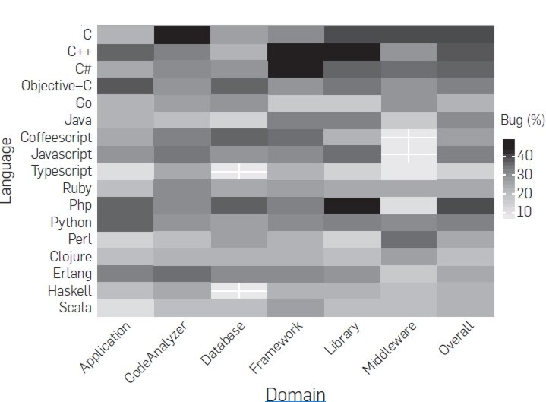
C++ is error prone
https://www.i-programmer.info/news/98-languages/11184-which-languages-are-bug-prone.html

Slide 5
Popularity according to TIOBE index
Jun 2019 | Programming Language | Ratings | Yearly change
1 | Java | 15.004% | -0.36%
2 | C | 13.300% | -1.64%
3 | Python | 8.530% | +2.77%
4 | C++ | 7.384% | -0.95%
5 | Visual Basic .NET | 4.624% | +0.86%
6 | C# | 4.483% | +0.17%
7 | JavaScript | 2.716% | +0.22%
8 | PHP | 2.567% | -0.31%
9 | SQL | 2.224% | -0.12%
10 | Assembly language | 1.479% | +0.56%

Slide 6
Why is it so popular then?

Slide 7
Because it’s C with bells and whistles
Jun 2019 | Programming Language | Ratings | Yearly change
1 | Java | 15.004% | -0.36%
2 | C | 13.300% | -1.64%
3 | Python | 8.530% | +2.77%
4 | C++ | 7.384% | -0.95%
5 | Visual Basic .NET | 4.624% | +0.86%
6 | C# | 4.483% | +0.17%
7 | JavaScript | 2.716% | +0.22%
8 | PHP | 2.567% | -0.31%
9 | SQL | 2.224% | -0.12%
10 | Assembly language | 1.479% | +0.56%

Slide 8
Where does C popularity grow from?

Slide 9
From USA Justice Department
In 1949, the Justice Department filed an antitrust suit aimed at forcing the divestiture of Western Electric, which was settled seven years later by AT&T's agreement to confine its products and services to common carrier telecommunications and license its patents to "all interested parties." A key effect of this was to ban AT&T from selling computers despite its key role in electronics research and development. Nonetheless, technological innovation continued.
Here comes UNIX and C:
1973 - licensed it to educational institutions;
1978 - over 600 machines were running Unix in some form;
1981 - licensees could sell binary sublicenses for as little as US $ 100;
1983 - less than 20,000 lines of code – almost all in C – composed the Unix kernel.
In 1983, the U.S. Department of Justice settled its second antitrust case against AT&T and broke up the Bell System. This relieved AT&T of the 1956 consent decree that had prevented them from turning Unix into a product. AT&T promptly rushed to commercialize Unix System V, a move that nearly killed Unix.

Slide 10
Small, cheap, portable. And it’s there
1985
Lisp Machine $ 50 000
v.s.
AT&T UNIX PC $ 5 590
Unix and C are the ultimate computer viruses [Richard P. Gabriel]

Slide 11
Do you know C?
C is smaller.
C is older.
C code is easier:
to write,
to disassemble,
to profile,
to debug.
Compiler is easier to implement.
Linking is simpler.
C is the lingua franca for interfaces between all the other languages.
Everybody knows C right?

Slide 12
Do you know C?
struct S
{
int i;
char c;
} s;
main()
{
return sizeof(*(&s));
}
A. 4
B. 5
C. 8
D. I don't know.

Slide 13
Do you know C?
main()
{
char a = 0;
short int b = 0;
return sizeof(b) == sizeof(a+b);
}
A. 0
B. 1
C. 2
D. I don't know.

Slide 14
Do you know C?
main()
{
char a = ‘ ‘ * 13;
return a;
}
A. 416
B. 160
C. -96
D. I don't know.

Slide 15
Do you know C?
main()
{
int i = 16;
return (((((i >= i) << i) >> i) <= i));
}
A. 0
B. 1
C. 16
D. I don't know.

Slide 16
Do you know C?
main()
{
int i = 0;
return i++ + ++i;
}
A. 1
B. 2
C. 3
D. I don't know.

Slide 17
Nobody knows C
 | A | B | C | D
1 |  |  |  | ✔
2 |  |  |  | ✔
3 |  |  |  | ✔
4 |  |  |  | ✔
5 |  |  |  | ✔

Slide 18
1. Data padding is arbitrary
C compiler knows that storing unaligned data in RAM may be costly*, so it pads your data for you.
If you have 5 bytes of data in a structure, it will probably make it 8. Or 16. Or 6. Or whatever it wants.
There are extensions like GCC attributes aligned and packed that let you get some control over this process, but they are non-standard. C itself does not define padding attributes.
* - Although, it’s not necessary true.
See unaligned memory in Nehalem architecture.

Slide 19
2. Integer promotions are nuts
If both operands have the same type, then no further conversion is needed.
Otherwise, if both operands have signed integer types or both have unsigned integer types, the operand with the type of lesser integer conversion rank is converted to the type of the operand with greater rank.
Otherwise, if the operand that has unsigned integer type has rank greater or equal to the rank of the type of the other operand, then the operand with signed integer type is converted to the type of the operand with unsigned integer type.
Otherwise, if the type of the operand with signed integer type can represent all of the values of the type of the operand with unsigned integer type, then the operand with unsigned integer type is converted to the type of the operand with signed integer type.
Otherwise, both operands are converted to the unsigned integer type corresponding to the type of the operand with signed integer type.
ISO/IEC 9899:201x

Slide 20
2. Integer promotions are nuts
int main()
{
uint16_t a = 50000;
uint16_t b = 50000;
uint64_t c = a*b;
assert(c == 2500000000);
}
Why the assert should fail?

Slide 21
2. Integer promotions are nuts
If both operands have the same type, then no further conversion is needed.
Otherwise, if both operands have signed integer types or both have unsigned integer types, the operand with the type of lesser integer conversion rank is converted to the type of the operand with greater rank.
Otherwise, if the operand that has unsigned integer type has rank greater or equal to the rank of the type of the other operand, then the operand with signed integer type is converted to the type of the operand with unsigned integer type.
Otherwise, if the type of the operand with signed integer type can represent all of the values of the type of the operand with unsigned integer type, then the operand with unsigned integer type is converted to the type of the operand with signed integer type.
Otherwise, both operands are converted to the unsigned integer type corresponding to the type of the operand with signed integer type.
ISO/IEC 9899:201x

Slide 22
3. char type is not an ASCII character
Neither integer overflows, nor char type sign are defined by the standard. First one is undefined behavior, the second is implementation specific.
But even more, the size of the char type itself is not specified in bits either. There were platforms where it was 6 bits (remember trigraphs*?), and there are platforms where all five integer types are 32 bits.
Sizes are defined as macros in <limits.h> for every particular compiler implementation.
* - Before any other processing takes place, each occurrence of one of the following sequences of three characters (called trigraph sequences) is replaced with the corresponding single character.
??= # ??( [ ??/ \
??) ] ??’ ^ ??< {
??! | ??> } ??- ~

Slide 23
4. Over-shifts int16_t(x) << 16 are undefined behavior
Just as with char, int size is not directly specified in the standard either. It can easily be 16 bits, then the very first operation will cause the over-shift and that’s plain undefined behavior.
It’s not C fault, on some platforms, it is even undefined in assembly, so the compiler simply can’t give you valid guarantees without eating up a lot of performance.

Slide 24
5. Operand evaluation order is unspecified
Neither order of operand evaluation for +, nor even the order of precedence between increment operators are specified, so basically every nontrivial operation that involves i++ and ++i is a pitfall since they alter their operand.
It might work just like you expect on one platform and might fail easily on the other. Or not. That’s the problem with unspecified things.

Slide 25
The worst part*, compilers are de-facto consistent
mov eax, 2
ret 0
main()
{
int i = 0;
return i++ + ++i;
}
addi a0, zero, 2
ret
mov r0, #2
bx lr
j $31
li $2,2 # 0x2
* - you learn things without guarantees.

Slide 26
In what way C++ is better?

Slide 27
Abstraction is a misnomer
This is Bob.
Bob spent years proving theorems for square matrices
This is Bob when he learned that square matrices don’t attract funding anymore.
This is Bob when he learned that square matrices and integers modulo X share the same algebra.
Bob spent a night doing “Ctrl-c + Ctrl-v” and he is now world class specialist in uint32_t.
Abstract algebra – yes.
Abstract computing – no.

Slide 28
One last puzzle
#define int64 unsigned long long int
int main()
{
assert(sizeof(int64) == 8); // let’s say it’s true
int64 a, b, c = 2;
for(int i = 0; i < 6; i++)
{
a = b = c;
c = a * b;
printf("%d * %d = %d\n", a, b, c);
}
}
What will be
the print out?

Slide 29
Nope
That’s what you get*
2 * 0 = 2
4 * 0 = 4
16 * 0 = 16
256 * 0 = 256
65536 * 0 = 65536
0 * 1 = 0
WHAT?
WHAT?
* - in MSVC though. GCC is slightly different.

Slide 30
Show me the faulty line
1 #define int64 unsigned long long int
2
3 int main()
4 {
5 assert(sizeof(int64) == 8);
6 int64 a, b, c = 2;
7 for(int i = 0; i < 6; i++)
8 {
9 a = b = c;
10 c = a * b;
11 printf("%d * %d = %d\n", a, b, c);
12 }
13 }

Slide 31
The magic of printf
Each conversion speciﬁcation is introduced by the character %. After the %, the following appear in sequence:
— Zero or more ﬂags (in any order) that modify the meaning of the conversion speciﬁcation.
— An optional minimum ﬁeld width. If the converted value has fewer characters than the ﬁeld width, it is padded with spaces (by default) on the left (or right, if the left adjustment ﬂag, described later, has been given) to the ﬁeld width. The ﬁeld width takes the form of an asterisk * (described later) or a nonnegative decimal integer.275) — An optional precision that gives the minimum number of digits to appear for the d, i, o, u, x, and X conversions, the number of digits to appear after the decimal-point character for a, A, e, E, f, and F conversions, the maximum number of signiﬁcant digits for the g and G conversions, or the maximum number of bytes to be written for s conversions. The precision takes the form of a period (.) followed either by an asterisk * (described later) or by an optional decimal integer; if only the period is speciﬁed, the precision is taken as zero. If a precision appears with any other conversion speciﬁer, the behavior is undeﬁned.
— An optional length modiﬁer that speciﬁes the size of the argument.
— A conversion speciﬁer character that speciﬁes the type of conversion to be applied.

Slide 32
The magic of printf
printf("%lld * %lld = %lld\n", a, b, c);
2 * 2 = 4
4 * 4 = 16
16 * 16 = 256
256 * 256 = 65536
65536 * 65536 = 4294967296
4294967296 * 4294967296 = 0
A legit overflow

Slide 33
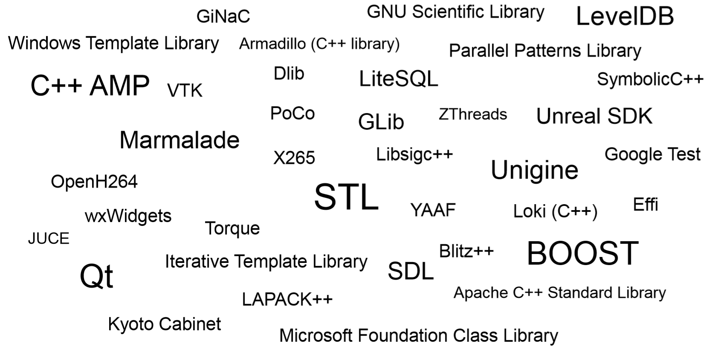
C++ is better at creating sub-languages (SDKs, frameworks, libraries)

Slide 34
Better is subjective
#include <iostream>
int main()
{
std::string hw{"Hello, world!"};
std::cout << hw;
}
$gcc –std=c++11 test.cpp –o test
$./test

Slide 35
Better is subjective
/tmp/ccCjudwJ.o: In function `main':
cout_test.cpp:(.text+0x11): undefined reference to `std::allocator<char>::allocator()'
cout_test.cpp:(.text+0x28): undefined reference to `std::__cxx11::basic_string<char, std::char_traits<char>, std::allocator<char> >::basic_string(char const*, std::allocator<char> const&)'
cout_test.cpp:(.text+0x34): undefined reference to `std::allocator<char>::~allocator()'
cout_test.cpp:(.text+0x42): undefined reference to `std::cout'
cout_test.cpp:(.text+0x47): undefined reference to `std::basic_ostream<char, std::char_traits<char> >& std::operator<< <char, std::char_traits<char>, std::allocator<char> >(std::basic_ostream<char, std::char_traits<char> >&, std::__cxx11::basic_string<char, std::char_traits<char>, std::allocator<char> > const&)'
cout_test.cpp:(.text+0x53): undefined reference to `std::__cxx11::basic_string<char, std::char_traits<char>, std::allocator<char> >::~basic_string()'
cout_test.cpp:(.text+0x69): undefined reference to `std::allocator<char>::~allocator()'
cout_test.cpp:(.text+0x83): undefined reference to `std::__cxx11::basic_string<char, std::char_traits<char>, std::allocator<char> >::~basic_string()'
/tmp/ccCjudwJ.o: In function `__static_initialization_and_destruction_0(int, int)':
cout_test.cpp:(.text+0xbe): undefined reference to `std::ios_base::Init::Init()'
cout_test.cpp:(.text+0xd3): undefined reference to `std::ios_base::Init::~Init()'
/tmp/ccCjudwJ.o:(.data.DW.ref.__gxx_personality_v0[DW.ref.__gxx_personality_v0]+0x0): undefined reference to `__gxx_personality_v0'
collect2: error: ld returned 1 exit status

Slide 36
Does C++ have pitfalls? Yes.
int *x = new int;
delete [] x;
int y = 1 << -1;
void f() {
volatile int x=0;
int &y=const_cast<int&>(x);
std::cout << y;
}
int x = 1/0;
struct X {};
void f() {
X *x=nullptr;
x->~X();
}
static const int arrs[10]{};
void f() {
const int* y = arrs + 10;
}
int x=1;
char *c=reinterpret_cast<char*>(&x);
x = *c;
http://www.open-std.org/jtc1/sc22/wg21/docs/papers/2019/p1705r0.html

Slide 37
Can you avoid them? Yes.
Education
Coding standards
Compiler warnings
Static analyzers
Dynamic analyzers
Profilers
Unit tests
Integration tests
Manual testing
Customer complaints

Slide 38
Education
The Design and Evolution of C++ Bjarne Stroustrup
Effective Modern C++ (C++, More C++, STL) Scott Meyers*
Exceptional C++ (More C++, Style) Herb Sutter
Modern C++ Design Andrei Alexandrescu
From Mathematics to Generic Programming Alexander Stepanov, Daniel E. Rose
Secure Coding in C and C++ Robert C. Seacord
Optimizing software in C++ Agner Fog https://www.agner.org/optimize/optimizing_cpp.pdf
* - let it be your homework: watch The Last Thing D Needs by Scott Meyers

Slide 39
Coding standards
C++ Core Guidelines https://github.com/isocpp/CppCoreGuidelines/blob/master/CppCoreGuidelines.md
AUTOSAR Guidelines for the use of the C++ language in critical and safety-related systems https://www.autosar.org/fileadmin/user_upload/standards/adaptive/17-03/AUTOSAR_RS_CPP14Guidelines.pdf
HIC++ 4.0 by Perforce https://www.perforce.com/blog/qac/high-integrity-cpp-hicpp
SEI CERT C++ Coding Standard https://resources.sei.cmu.edu/library/asset-view.cfm?assetID=494932
ISO/IEC TR 24772:2013 Guidance to avoiding vulnerabilities in programming languages through language selection and use http://www.open-std.org/jtc1/sc22/wg23/docs/ISO-IECJTC1-SC22-WG23_N0751-tr24772-1-after-pre-meeting-51-webex-20171016.pdf
C++ Coding Standards: 101 Rules, Guidelines, and Best Practices Herb Sutter, Andrei Alexandrescu
MISRA C++ 2008
JSF C++ (2005) http://www.stroustrup.com/JSF-AV-rules.pdf

Slide 40
Coding standard rule example (from HIC++ 4.0)
12.4.4 Write members in an initialization list in the order in which they are declared
Regardless of the order of member initializers in a initialization list, the order of initialization is always:
Virtual base classes in depth and left to right order of the inheritance graph.
Direct non-virtual base classes in left to right order of inheritance list.
Non-static member data in order of declaration in the class definition.
To avoid confusion and possible use of uninitialized data members, it is recommended that the initialization list matches the actual initialization order.
For Example:
#include <cstdint>
class B {};
class VB: public virtual B {};
class C {};
class DC: public VB , public C {
public:
DC(): B(), VB(), C(), i(1), c() {}
private:
int32_t i;
C c;
};

Slide 41
Compiler warnings (GCC example)
-Wall:
-Waddress -Warray-bounds=1 -Wbool-compare -Wbool-operation -Wc++11-compat -Wc++14-compat -Wcatch-value
-Wchar-subscripts -Wcomment -Wduplicate-decl-specifier
-Wenum-compare -Wformat -Wint-in-bool-context -Wimplicit
-Wimplicit-int -Wimplicit-function-declaration -Winit-self
-Wlogical-not-parentheses –Wmain -Wmaybe-uninitialized
-Wmemset-elt-size -Wmemset-transposed-args -Wmisleading-indentation -Wmissing-attributes -Wmissing-braces
-Wmultistatement-macros -Wnarrowing -Wnonnull -Wnonnull-compare -Wopenmp-simd -Wparentheses -Wpessimizing-move
-Wpointer-sign -Wreorder -Wrestrict -Wreturn-type -Wsequence-point -Wsign-compare -Wsizeof-pointer-div -Wsizeof-pointer-memaccess -Wstrict-aliasing -Wstrict-overflow=1 -Wswitch
-Wtautological-compare -Wtrigraphs -Wuninitialized -Wunknown-pragmas -Wunused-function -Wunused-label
-Wunused-value -Wunused-variable -Wvolatile-register-var

Slide 42
Compiler warnings (GCC example)
-Wextra:
-Wclobbered
-Wcast-function-type
-Wdeprecated-copy (C++ only)
-Wempty-body
-Wignored-qualifiers
-Wimplicit-fallthrough=3
-Wmissing-field-initializers
-Wmissing-parameter-type (C only)
-Wold-style-declaration (C only)
-Woverride-init
-Wsign-compare (C only)
-Wredundant-move (only for C++)
-Wtype-limits
-Wuninitialized
-Wshift-negative-value (in C++03 and in C99 and newer)
-Wunused-parameter (only with -Wunused or -Wall)
-Wunused-but-set-parameter (only with -Wunused or -Wall)

Slide 43
Compiler warnings (GCC example)
+
-Wduplicated-cond x == 0 || y ==0 || y ==0
-Wduplicated-branches x = y>0 ? 1 : 1;
-Wlogical-op rgba = rgba || 0x00FFFFFF;
-Wrestrict
-Wnull-dereference p = a > 0 ? &a : nullptr; return *p;
-Wold-style-cast
-Wuseless-cast int truncate(int x) {return static_cast<int>(x);}
-Wjump-misses-init
-Wdouble-promotion float disk_area(float x) {return 3.1415*x*x;}
-Wshadow
-Wformat=2 void foo(char *p) { printf(p); }
https://gcc.gnu.org/onlinedocs/gcc/Warning-Options.html
https://kristerw.blogspot.com/2017/09/useful-gcc-warning-options-not-enabled.html

Slide 44
Static analyzers
CppCheck: http://cppcheck.sourceforge.net/
In development since 2009.
Has 230 contributors.
Covers 200+ defect classes.
Supports custom formatting. May be integrated to anything.
memset(ctx, 0, sizeof(ctx));
[blablabla\md5.c:160]: (warning, inconclusive) Size of pointer 'ctx' used instead of size of its data. This is likely to lead to a buffer overflow. You probably intend to write 'sizeof(*ctx)'

Slide 45
Dynamic analyzers
Dr. Memory
In development since 2013
Open source (LGPL)
Based on DynamoRIO.
Error #55: POSSIBLE LEAK 80 direct bytes 0x034b00f8-0x034b0148 + 0 indirect bytes
# 0 replace_malloc [d:\drmemory_package\common\alloc_replace.c:2292]
# 1 msvcrt.dll!strcpy_s +0x5e (0x769ff5d3 <msvcrt.dll+0xf5d3>)
# 2 msvcrt.dll!clearerr_s +0x337 (0x76a09eed <msvcrt.dll+0x19eed>)
# 3 msvcrt.dll!clearerr_s +0x27e (0x76a09e34 <msvcrt.dll+0x19e34>)
# 4 cppcheck-gui.exe!? +0x0 (0x0040104a <cppcheck-gui.exe+0x104a>)
# 5 cppcheck-gui.exe!? +0x0 (0x00401471 <cppcheck-gui.exe+0x1471>)
# 6 KERNEL32.dll!BaseThreadInitThunk +0x11 (0x767933ca <KERNEL32.dll+0x133ca>)

Slide 46
Dynamic analyzers
Valgrind: http://www.valgrind.org/info/about.html
More versatile:
memcheck
cachegrind
callgrind
helgrind
DRD
massif
DHAT
etc
I refs: 13,041,321,061
I1 misses: 1,843
LLi misses: 1,705
I1 miss rate: 0.00%
LLi miss rate: 0.00%
D refs: 7,438,562,794 (4,742,035,917 rd + 2,696,526,877 wr)
D1 misses: 15,894 ( 13,676 rd + 2,218 wr)
LLd misses: 9,156 ( 7,761 rd + 1,395 wr)
D1 miss rate: 0.0% ( 0.0% + 0.0% )
LLd miss rate: 0.0% ( 0.0% + 0.0% )
LL refs: 17,737 ( 15,519 rd + 2,218 wr)
LL misses: 10,861 ( 9,466 rd + 1,395 wr)
LL miss rate: 0.0% ( 0.0% + 0.0% )

Slide 47
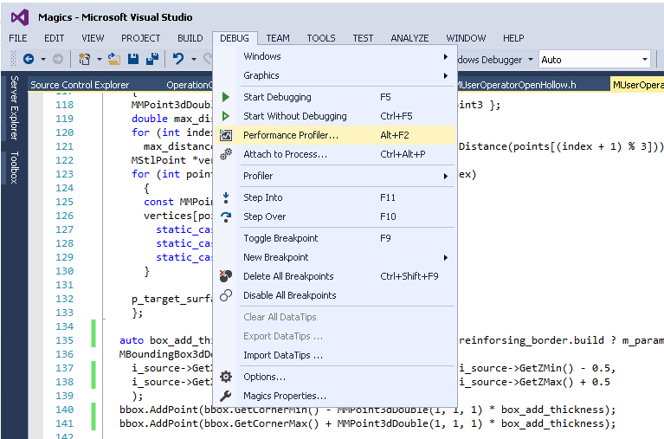
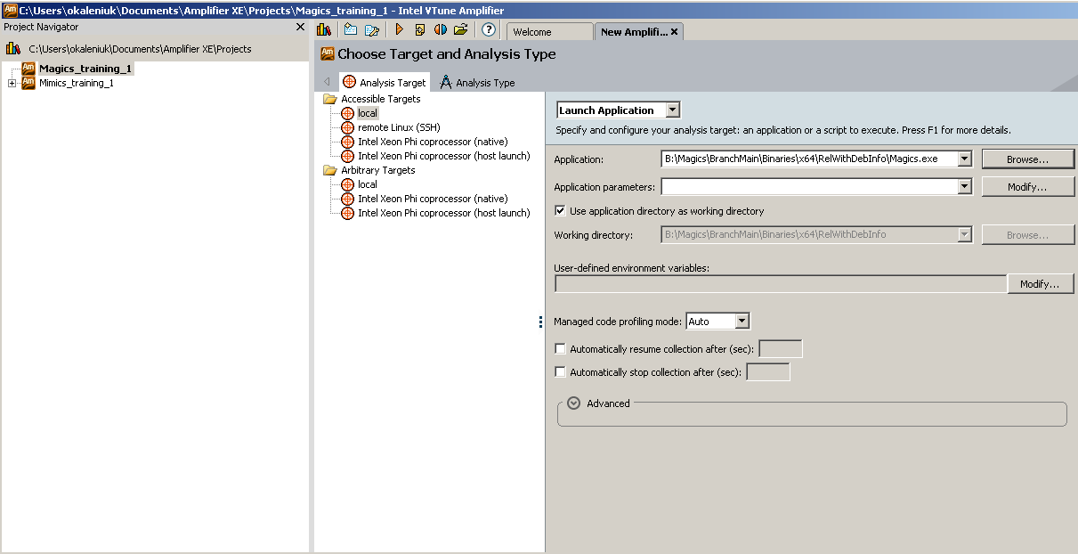
Profilers
Conceptually simple:
You run your program and it will collect some data for you!
Accidentally complex:
Your program may not run, profiler may not start run, scenario might get impossible to reproduce, overhead would become overwhelming, and the data will be irrelevant.
VS
VTune Amplifier

Slide 48
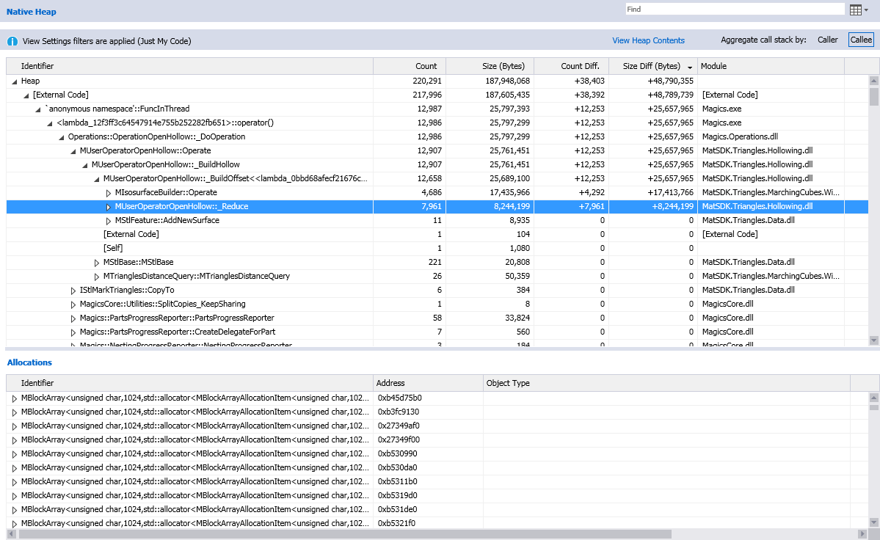
Profilers: VS
Shows sample count per function
Retain relations (call tree)
Shows memory consumption
Compares between snapshot
Has instrumental option

Slide 49
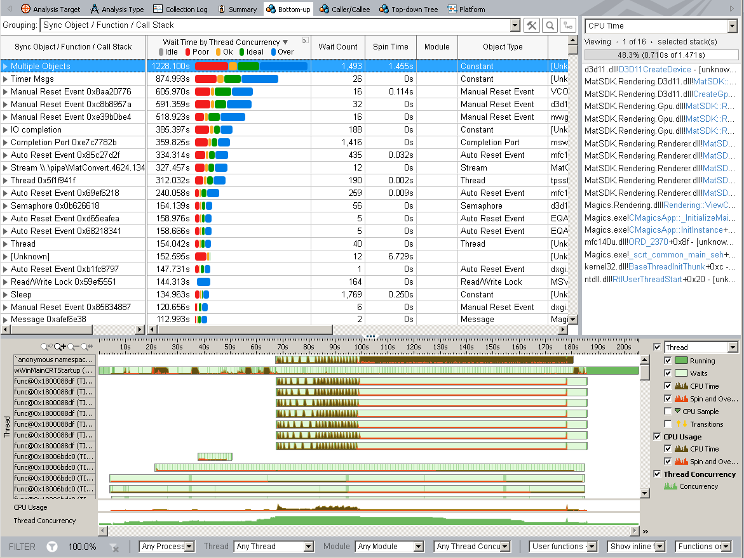
Profilers: VTune Amplifier
Shows overall concurrency picture
Shows per thread load
Shows spin time, locks and waits

Slide 50
Does intuition (or experience) work instead of profiler?

Slide 51
Let’s try it out with magic squares
8 | 1 | 6
3 | 5 | 7
4 | 9 | 2
#include <iostream>
#include <chrono>
using namespace std;
bool check_if_magic(const std::string& square)
{
// add your code here
// ...
return false;
}
= “816357492”
// this generates all possible combinations
// of 1-9 digits that may or may not
// form a magic square
static string buffer = "000000000";
void generate_or_check(int index_or_check = 8)
{
if(index_or_check == -1){
if(check_if_magic(buffer))
cout << buffer << " ";
return;
}
for(auto i = 1u; i < 10; ++i){
buffer[index_or_check] = '0' + i;
generate_or_check(index_or_check-1);
}
}
// this runs the generator and measures time
int main()
{
auto start = std::chrono::system_clock::now();
generate_or_check();
auto end = std::chrono::system_clock::now();
chrono::duration<double>
difference = end - start;
cout << difference.count() << "\n\n";
}

Slide 52
Which one is faster?
auto c15 = '5' * 3; uint_fast64_t ideal_char_map = static_cast<uint_fast64_t>(0x1FF) << 49; uint_fast64_t char_map_one = 1u; bool check_if_magic(const std::string& sq) { if ((sq[0] + sq[1] + sq[2] != c15) || (sq[3] + sq[4] + sq[5] != c15) || (sq[6] + sq[7] + sq[8] != c15) || (sq[0] + sq[3] + sq[6] != c15) || (sq[1] + sq[4] + sq[7] != c15) || (sq[2] + sq[5] + sq[8] != c15) || (sq[0] + sq[4] + sq[8] != c15) || (sq[2] + sq[4] + sq[6] != c15)) return false; auto char_map = ideal_char_map; for(auto i = 0u; i < 9; ++i) char_map ^= char_map_one << sq[i]; if (char_map != 0) return false; return true; } | auto c15 = '5' * 3; uint_fast64_t ideal_char_map = static_cast<uint_fast64_t>(0x1FF) << 49; uint_fast64_t char_map_one = 1u; bool check_if_magic(const std::string& sq) { if ( (sq[0] & 1) != 0 || (sq[1] & 1) == 0 || (sq[2] & 1) != 0 || (sq[3] & 1) == 0 || (sq[4] & 1) == 0 || (sq[5] & 1) == 0 || (sq[6] & 1) != 0 || (sq[7] & 1) == 0 || (sq[8] & 1) != 0) return false; if ((sq[0] + sq[1] + sq[2] != c15) || (sq[3] + sq[4] + sq[5] != c15) || (sq[6] + sq[7] + sq[8] != c15) || (sq[0] + sq[3] + sq[6] != c15) || (sq[1] + sq[4] + sq[7] != c15) || (sq[2] + sq[5] + sq[8] != c15) || (sq[0] + sq[4] + sq[8] != c15) || (sq[2] + sq[4] + sq[6] != c15)) return false; auto char_map = ideal_char_map; for(auto i = 0u; i < 9; ++i) char_map ^= char_map_one << sq[i]; if (char_map != 0) return false; return true; }

Slide 53
The right one is 10% faster
auto c15 = '5' * 3; uint_fast64_t ideal_char_map = static_cast<uint_fast64_t>(0x1FF) << 49; uint_fast64_t char_map_one = 1u; bool check_if_magic(const std::string& sq) { if ((sq[0] + sq[1] + sq[2] != c15) || (sq[3] + sq[4] + sq[5] != c15) || (sq[6] + sq[7] + sq[8] != c15) || (sq[0] + sq[3] + sq[6] != c15) || (sq[1] + sq[4] + sq[7] != c15) || (sq[2] + sq[5] + sq[8] != c15) || (sq[0] + sq[4] + sq[8] != c15) || (sq[2] + sq[4] + sq[6] != c15)) return false; auto char_map = ideal_char_map; for(auto i = 0u; i < 9; ++i) char_map ^= char_map_one << sq[i]; if (char_map != 0) return false; return true; } | auto c15 = '5' * 3; uint_fast64_t ideal_char_map = static_cast<uint_fast64_t>(0x1FF) << 49; uint_fast64_t char_map_one = 1u; bool check_if_magic(const std::string& sq) { if ( (sq[0] & 1) != 0 || (sq[1] & 1) == 0 || (sq[2] & 1) != 0 || (sq[3] & 1) == 0 || (sq[4] & 1) == 0 || (sq[5] & 1) == 0 || (sq[6] & 1) != 0 || (sq[7] & 1) == 0 || (sq[8] & 1) != 0) return false; if ((sq[0] + sq[1] + sq[2] != c15) || (sq[3] + sq[4] + sq[5] != c15) || (sq[6] + sq[7] + sq[8] != c15) || (sq[0] + sq[3] + sq[6] != c15) || (sq[1] + sq[4] + sq[7] != c15) || (sq[2] + sq[5] + sq[8] != c15) || (sq[0] + sq[4] + sq[8] != c15) || (sq[2] + sq[4] + sq[6] != c15)) return false; auto char_map = ideal_char_map; for(auto i = 0u; i < 9; ++i) char_map ^= char_map_one << sq[i]; if (char_map != 0) return false; return true; }

Slide 54
Which one is faster?
auto c15 = '5' * 3; uint_fast64_t ideal_char_map = static_cast<uint_fast64_t>(0x1FF) << 49; uint_fast64_t char_map_one = 1u; bool check_if_magic(const std::string& sq) { if ((sq[0] + sq[1] + sq[2] != c15) || (sq[3] + sq[4] + sq[5] != c15) || (sq[6] + sq[7] + sq[8] != c15) || (sq[0] + sq[3] + sq[6] != c15) || (sq[1] + sq[4] + sq[7] != c15) || (sq[2] + sq[5] + sq[8] != c15) || (sq[0] + sq[4] + sq[8] != c15) || (sq[2] + sq[4] + sq[6] != c15)) return false; auto char_map = ideal_char_map; for(auto i = 0u; i < 9; ++i) char_map ^= char_map_one << sq[i]; if (char_map != 0) return false; return true; } | auto magic_number = '5' * 3; auto not_so_magic_number = '5' * 2; uint_fast64_t ideal_char_map = static_cast<uint_fast64_t>(0x1FF) << 49; uint_fast64_t char_map_one = 1u; bool check_if_magic(const std::string& sq) { if(sq[4] != '5') return false; if ((sq[0] + sq[1] + sq[2] != magic_number) || (sq[3] + sq[5] != not_so_magic_number) || (sq[6] + sq[7] + sq[8] != magic_number) || (sq[0] + sq[3] + sq[6] != magic_number) || (sq[1] + sq[7] != not_so_magic_number) || (sq[2] + sq[5] + sq[8] != magic_number) || (sq[0] + sq[8] != not_so_magic_number) || (sq[2] + sq[6] != not_so_magic_number)) return false; auto char_map = ideal_char_map; for(auto i = 0u; i < 9; ++i) char_map ^= char_map_one << sq[i]; if (char_map != 0) return false; return true; }

Slide 55
The right one is 50% faster
auto c15 = '5' * 3; uint_fast64_t ideal_char_map = static_cast<uint_fast64_t>(0x1FF) << 49; uint_fast64_t char_map_one = 1u; bool check_if_magic(const std::string& sq) { if ((sq[0] + sq[1] + sq[2] != c15) || (sq[3] + sq[4] + sq[5] != c15) || (sq[6] + sq[7] + sq[8] != c15) || (sq[0] + sq[3] + sq[6] != c15) || (sq[1] + sq[4] + sq[7] != c15) || (sq[2] + sq[5] + sq[8] != c15) || (sq[0] + sq[4] + sq[8] != c15) || (sq[2] + sq[4] + sq[6] != c15)) return false; auto char_map = ideal_char_map; for(auto i = 0u; i < 9; ++i) char_map ^= char_map_one << sq[i]; if (char_map != 0) return false; return true; } | auto magic_number = '5' * 3; auto not_so_magic_number = '5' * 2; uint_fast64_t ideal_char_map = static_cast<uint_fast64_t>(0x1FF) << 49; uint_fast64_t char_map_one = 1u; bool check_if_magic(const std::string& sq) { if(sq[4] != '5') return false; if ((sq[0] + sq[1] + sq[2] != magic_number) || (sq[3] + sq[5] != not_so_magic_number) || (sq[6] + sq[7] + sq[8] != magic_number) || (sq[0] + sq[3] + sq[6] != magic_number) || (sq[1] + sq[7] != not_so_magic_number) || (sq[2] + sq[5] + sq[8] != magic_number) || (sq[0] + sq[8] != not_so_magic_number) || (sq[2] + sq[6] != not_so_magic_number)) return false; auto char_map = ideal_char_map; for(auto i = 0u; i < 9; ++i) char_map ^= char_map_one << sq[i]; if (char_map != 0) return false; return true; }

Slide 56
Which one is faster?
auto c15 = '5' * 3; uint_fast64_t ideal_char_map = static_cast<uint_fast64_t>(0x1FF) << 49; uint_fast64_t char_map_one = 1u; bool check_if_magic(const std::string& sq) { if ((sq[0] + sq[1] + sq[2] != c15) || (sq[3] + sq[4] + sq[5] != c15) || (sq[6] + sq[7] + sq[8] != c15) || (sq[0] + sq[3] + sq[6] != c15) || (sq[1] + sq[4] + sq[7] != c15) || (sq[2] + sq[5] + sq[8] != c15) || (sq[0] + sq[4] + sq[8] != c15) || (sq[2] + sq[4] + sq[6] != c15)) return false; auto char_map = ideal_char_map; for(auto i = 0u; i < 9; ++i) char_map ^= char_map_one << sq[i]; if (char_map != 0) return false; return true; } | auto magic_number = '5' * 3; const std::array<uint16_t, 58> bit_shifts { 0, 0, 0, 0, 0, 0, 0, 0, 0, 0, 0, 0, 0, 0, 0, 0, 0, 0, 0, 0, 0, 0, 0, 0, 0, 0, 0, 0, 0, 0, 0, 0, 0, 0, 0, 0, 0, 0, 0, 0, 0, 0, 0, 0, 0, 0, 0, 0, 0, 1, 2, 4, 8, 16, 32, 64, 128, 256 }; bool check_if_magic(const std::string& sq) { if ((sq[0] + sq[1] + sq[2] != c15) || (sq[3] + sq[4] + sq[5] != c15) || (sq[6] + sq[7] + sq[8] != c15) || (sq[0] + sq[3] + sq[6] != c15) || (sq[1] + sq[4] + sq[7] != c15) || (sq[2] + sq[5] + sq[8] != c15) || (sq[0] + sq[4] + sq[8] != c15) || (sq[2] + sq[4] + sq[6] != c15)) return false; auto char_map = 0u; for(auto i = 0u; i < 9; ++i) char_map ^= bit_shifts[sq[i]]; if (char_map != 511) return false; return true; }

Slide 57
Right is 25% faster
auto c15 = '5' * 3; uint_fast64_t ideal_char_map = static_cast<uint_fast64_t>(0x1FF) << 49; uint_fast64_t char_map_one = 1u; bool check_if_magic(const std::string& sq) { if ((sq[0] + sq[1] + sq[2] != c15) || (sq[3] + sq[4] + sq[5] != c15) || (sq[6] + sq[7] + sq[8] != c15) || (sq[0] + sq[3] + sq[6] != c15) || (sq[1] + sq[4] + sq[7] != c15) || (sq[2] + sq[5] + sq[8] != c15) || (sq[0] + sq[4] + sq[8] != c15) || (sq[2] + sq[4] + sq[6] != c15)) return false; auto char_map = ideal_char_map; for(auto i = 0u; i < 9; ++i) char_map ^= char_map_one << sq[i]; if (char_map != 0) return false; return true; } | auto magic_number = '5' * 3; const std::array<uint16_t, 58> bit_shifts { 0, 0, 0, 0, 0, 0, 0, 0, 0, 0, 0, 0, 0, 0, 0, 0, 0, 0, 0, 0, 0, 0, 0, 0, 0, 0, 0, 0, 0, 0, 0, 0, 0, 0, 0, 0, 0, 0, 0, 0, 0, 0, 0, 0, 0, 0, 0, 0, 0, 1, 2, 4, 8, 16, 32, 64, 128, 256 }; bool check_if_magic(const std::string& sq) { if ((sq[0] + sq[1] + sq[2] != c15) || (sq[3] + sq[4] + sq[5] != c15) || (sq[6] + sq[7] + sq[8] != c15) || (sq[0] + sq[3] + sq[6] != c15) || (sq[1] + sq[4] + sq[7] != c15) || (sq[2] + sq[5] + sq[8] != c15) || (sq[0] + sq[4] + sq[8] != c15) || (sq[2] + sq[4] + sq[6] != c15)) return false; auto char_map = 0u; for(auto i = 0u; i < 9; ++i) char_map ^= bit_shifts[sq[i]]; if (char_map != 511) return false; return true; }

Slide 58
Valgrind
I refs: 13,099,624,571 I1 misses: 1,846 LLi misses: 1,705 I1 miss rate: 0.00% LLi miss rate: 0.00% D refs: 7,435,891,049 (4,739,364,171 rd + 2,696,526,878 wr) D1 misses: 15,886 ( 13,670 rd + 2,216 wr) LLd misses: 9,155 ( 7,758 rd + 1,397 wr) D1 miss rate: 0.0% ( 0.0% + 0.0% ) LLd miss rate: 0.0% ( 0.0% + 0.0% ) LL refs: 17,732 ( 15,516 rd + 2,216 wr) LL misses: 10,860 ( 9,463 rd + 1,397 wr) LL miss rate: 0.0% ( 0.0% + 0.0% ) | I refs: 13,041,321,061 I1 misses: 1,843 LLi misses: 1,705 I1 miss rate: 0.00% LLi miss rate: 0.00% D refs: 7,438,562,794 (4,742,035,917 rd + 2,696,526,877 wr) D1 misses: 15,894 ( 13,676 rd + 2,218 wr) LLd misses: 9,156 ( 7,761 rd + 1,395 wr) D1 miss rate: 0.0% ( 0.0% + 0.0% ) LLd miss rate: 0.0% ( 0.0% + 0.0% ) LL refs: 17,737 ( 15,519 rd + 2,218 wr) LL misses: 10,861 ( 9,466 rd + 1,395 wr) LL miss rate: 0.0% ( 0.0% + 0.0% )

Slide 59
Which one is faster?
auto c15 = '5' * 3; uint_fast64_t ideal_char_map = static_cast<uint_fast64_t>(0x1FF) << 49; uint_fast64_t char_map_one = 1u; bool check_if_magic(const std::string& sq) { if ((sq[0] + sq[1] + sq[2] != c15) || (sq[3] + sq[4] + sq[5] != c15) || (sq[6] + sq[7] + sq[8] != c15) || (sq[0] + sq[3] + sq[6] != c15) || (sq[1] + sq[4] + sq[7] != c15) || (sq[2] + sq[5] + sq[8] != c15) || (sq[0] + sq[4] + sq[8] != c15) || (sq[2] + sq[4] + sq[6] != c15)) return false; auto char_map = ideal_char_map; for(auto i = 0u; i < 9; ++i) char_map ^= char_map_one << sq[i]; if (char_map != 0) return false; return true; } | const std::array<std::string, 8> all_magic_squares = { "816357492", "492357816", "618753294", "294753618", "834159672", "672159834", "438951276", "276951438" }; bool check_if_magic(const std::string& sq) { for(auto i = 0u; i < 8; ++i) if(sq == all_magic_squares[i]) return true; return false; }

Slide 60
Left one is more than 10 times faster!
auto c15 = '5' * 3; uint_fast64_t ideal_char_map = static_cast<uint_fast64_t>(0x1FF) << 49; uint_fast64_t char_map_one = 1u; bool check_if_magic(const std::string& sq) { if ((sq[0] + sq[1] + sq[2] != c15) || (sq[3] + sq[4] + sq[5] != c15) || (sq[6] + sq[7] + sq[8] != c15) || (sq[0] + sq[3] + sq[6] != c15) || (sq[1] + sq[4] + sq[7] != c15) || (sq[2] + sq[5] + sq[8] != c15) || (sq[0] + sq[4] + sq[8] != c15) || (sq[2] + sq[4] + sq[6] != c15)) return false; auto char_map = ideal_char_map; for(auto i = 0u; i < 9; ++i) char_map ^= char_map_one << sq[i]; if (char_map != 0) return false; return true; } | const std::array<std::string, 8> all_magic_squares = { "816357492", "492357816", "618753294", "294753618", "834159672", "672159834", "438951276", "276951438" }; bool check_if_magic(const std::string& sq) { for(auto i = 0u; i < 8; ++i) if(sq == all_magic_squares[i]) return true; return false; }

Slide 61
Which one is faster?
const std::array<std::string, 8> all_magic_squares = { "816357492", "492357816", "618753294", "294753618", "834159672", "672159834", "438951276", "276951438" }; bool check_if_magic(const std::string& sq) { for(auto i = 0u; i < 8; ++i) if(sq == all_magic_squares[i]) return true; return false; } | const std::set<std::string> all_magic_squares = { "816357492", "492357816", "618753294", "294753618", "834159672", "672159834", "438951276", "276951438" }; bool check_if_magic(const std::string& sq) { return all_magic_squares.find(sq) != all_magic_squares.end()); }

Slide 62
Right one is 2 times faster
const std::array<std::string, 8> all_magic_squares = { "816357492", "492357816", "618753294", "294753618", "834159672", "672159834", "438951276", "276951438" }; bool check_if_magic(const std::string& sq) { for(auto i = 0u; i < 8; ++i) if(sq == all_magic_squares[i]) return true; return false; } | const std::set<std::string> all_magic_squares = { "816357492", "492357816", "618753294", "294753618", "834159672", "672159834", "438951276", "276951438" }; bool check_if_magic(const std::string& sq) { return all_magic_squares.find(sq) != all_magic_squares.end()); }

Slide 63
Which one is faster?
const std::set<std::string> all_magic_squares = { "816357492", "492357816", "618753294", "294753618", "834159672", "672159834", "438951276", "276951438" }; bool check_if_magic(const std::string& sq) { return all_magic_squares.find(sq) != all_magic_squares.end()); } | const std::unordered_set<std::string> all_magic_squares = { "816357492", "492357816", "618753294", "294753618", "834159672", "672159834", "438951276", "276951438" }; bool check_if_magic(const std::string& sq) { return all_magic_squares.find(sq) != all_magic_squares.end()); }

Slide 64
Left is 25% faster
const std::set<std::string> all_magic_squares = { "816357492", "492357816", "618753294", "294753618", "834159672", "672159834", "438951276", "276951438" }; bool check_if_magic(const std::string& sq) { return all_magic_squares.find(sq) != all_magic_squares.end()); } | const std::unordered_set<std::string> all_magic_squares = { "816357492", "492357816", "618753294", "294753618", "834159672", "672159834", "438951276", "276951438" }; bool check_if_magic(const std::string& sq) { return all_magic_squares.find(sq) != all_magic_squares.end()); }

Slide 65
Which one is faster?
const std::array<std::string, 8> all_magic_squares = { "816357492", "492357816", "618753294", "294753618", "834159672", "672159834", "438951276", "276951438" }; bool check_if_magic(const std::string& sq) { for(auto i = 0u; i < 8; ++i) if(sq == all_magic_squares[i]) return true; return false; } | const std::array<std::string, 8> all_magic_squares = { "816357492", "492357816", "618753294", "294753618", "834159672", "672159834", "438951276", "276951438" }; bool check_if_magic(const std::string& sq) { if ( (sq[0] & 1) != 0 || (sq[1] & 1) == 0 || (sq[2] & 1) != 0 || (sq[3] & 1) == 0 || (sq[4] & 1) == 0 || (sq[5] & 1) == 0 || (sq[6] & 1) != 0 || (sq[7] & 1) == 0 || (sq[8] & 1) != 0) return false; for(auto i = 0u; i < 8; ++i) if(sq == all_magic_squares[i]) return true; return false; }

Slide 66
The right one is more than 20 times faster!
const std::array<std::string, 8> all_magic_squares = { "816357492", "492357816", "618753294", "294753618", "834159672", "672159834", "438951276", "276951438" }; bool check_if_magic(const std::string& sq) { for(auto i = 0u; i < 8; ++i) if(sq == all_magic_squares[i]) return true; return false; } | const std::array<std::string, 8> all_magic_squares = { "816357492", "492357816", "618753294", "294753618", "834159672", "672159834", "438951276", "276951438" }; bool check_if_magic(const std::string& sq) { if ( (sq[0] & 1) != 0 || (sq[1] & 1) == 0 || (sq[2] & 1) != 0 || (sq[3] & 1) == 0 || (sq[4] & 1) == 0 || (sq[5] & 1) == 0 || (sq[6] & 1) != 0 || (sq[7] & 1) == 0 || (sq[8] & 1) != 0) return false; for(auto i = 0u; i < 8; ++i) if(sq == all_magic_squares[i]) return true; return false; }

Slide 67
Which one is faster?
auto c15 = '5' * 3; uint_fast64_t ideal_char_map = static_cast<uint_fast64_t>(0x1FF) << 49; uint_fast64_t char_map_one = 1u; bool check_if_magic(const std::string& sq) { if ((sq[0] + sq[1] + sq[2] != c15) || (sq[3] + sq[4] + sq[5] != c15) || (sq[6] + sq[7] + sq[8] != c15) || (sq[0] + sq[3] + sq[6] != c15) || (sq[1] + sq[4] + sq[7] != c15) || (sq[2] + sq[5] + sq[8] != c15) || (sq[0] + sq[4] + sq[8] != c15) || (sq[2] + sq[4] + sq[6] != c15)) return false; auto char_map = ideal_char_map; for(auto i = 0u; i < 9; ++i) char_map ^= char_map_one << sq[i]; if (char_map != 0) return false; return true; } | const std::array<uint64_t, 8> magic_numbers { 3545515123101087289, 3690191062107239479, 3544956562637535289, 3978984379655991859, 3689073941180135479, 4123101758198592049, 3977867258728887859, 4122543197735040049 }; bool check_if_magic(const std::string& sq) { if(sq[4] != '5') return false; uint64_t magic_number = *(reinterpret_cast<const uint32_t*> (sq.data())); magic_number <<= 32; magic_number += *(reinterpret_cast<const uint32_t*> (sq.data()+5)); for(auto i = 0u; i < 8; ++i) if(magic_number == magic_numbers[i]) return true; return false; }

Slide 68
Right is more than 50% faster
auto c15 = '5' * 3; uint_fast64_t ideal_char_map = static_cast<uint_fast64_t>(0x1FF) << 49; uint_fast64_t char_map_one = 1u; bool check_if_magic(const std::string& sq) { if ((sq[0] + sq[1] + sq[2] != c15) || (sq[3] + sq[4] + sq[5] != c15) || (sq[6] + sq[7] + sq[8] != c15) || (sq[0] + sq[3] + sq[6] != c15) || (sq[1] + sq[4] + sq[7] != c15) || (sq[2] + sq[5] + sq[8] != c15) || (sq[0] + sq[4] + sq[8] != c15) || (sq[2] + sq[4] + sq[6] != c15)) return false; auto char_map = ideal_char_map; for(auto i = 0u; i < 9; ++i) char_map ^= char_map_one << sq[i]; if (char_map != 0) return false; return true; } | const std::array<uint64_t, 8> magic_numbers { 3545515123101087289, 3690191062107239479, 3544956562637535289, 3978984379655991859, 3689073941180135479, 4123101758198592049, 3977867258728887859, 4122543197735040049 }; bool check_if_magic(const std::string& sq) { if(sq[4] != '5') return false; uint64_t magic_number = *(reinterpret_cast<const uint32_t*> (sq.data())); magic_number <<= 32; magic_number += *(reinterpret_cast<const uint32_t*> (sq.data()+5)); for(auto i = 0u; i < 8; ++i) if(magic_number == magic_numbers[i]) return true; return false; }

Slide 69
Which one is faster?
const std::array<uint64_t, 8> magic_numbers { 3545515123101087289, 3690191062107239479, 3544956562637535289, 3978984379655991859, 3689073941180135479, 4123101758198592049, 3977867258728887859, 4122543197735040049 }; bool check_if_magic(const std::string& sq) { if(sq[4] != '5') return false; uint64_t magic_number = *(reinterpret_cast<const uint32_t*> (sq.data())); magic_number <<= 32; magic_number += *(reinterpret_cast<const uint32_t*> (sq.data()+5)); for(auto i = 0u; i < 8; ++i) if(magic_number == magic_numbers[i]) return true; return false; } | const std::set<uint64_t> magic_numbers { 3545515123101087289, 3690191062107239479, 3544956562637535289, 3978984379655991859, 3689073941180135479, 4123101758198592049, 3977867258728887859, 4122543197735040049 }; bool check_if_magic(const std::string& sq) { if(sq[4] != '5') return false; uint64_t magic_number = *(reinterpret_cast<const uint32_t*> (sq.data())); magic_number <<= 32; magic_number += *(reinterpret_cast<const uint32_t*> (sq.data()+5)); return magic_numbers.find(magic_number) != magic_numbers.end(); }

Slide 70
Left is 25% faster
const std::array<uint64_t, 8> magic_numbers { 3545515123101087289, 3690191062107239479, 3544956562637535289, 3978984379655991859, 3689073941180135479, 4123101758198592049, 3977867258728887859, 4122543197735040049 }; bool check_if_magic(const std::string& sq) { if(sq[4] != '5') return false; uint64_t magic_number = *(reinterpret_cast<const uint32_t*> (sq.data())); magic_number <<= 32; magic_number += *(reinterpret_cast<const uint32_t*> (sq.data()+5)); for(auto i = 0u; i < 8; ++i) if(magic_number == magic_numbers[i]) return true; return false; } | const std::set<uint64_t> magic_numbers { 3545515123101087289, 3690191062107239479, 3544956562637535289, 3978984379655991859, 3689073941180135479, 4123101758198592049, 3977867258728887859, 4122543197735040049 }; bool check_if_magic(const std::string& sq) { if(sq[4] != '5') return false; uint64_t magic_number = *(reinterpret_cast<const uint32_t*> (sq.data())); magic_number <<= 32; magic_number += *(reinterpret_cast<const uint32_t*> (sq.data()+5)); return magic_numbers.find(magic_number) != magic_numbers.end(); }

Slide 71
Which one is faster?
const std::array<uint64_t, 8> magic_numbers { 3545515123101087289, 3690191062107239479, 3544956562637535289, 3978984379655991859, 3689073941180135479, 4123101758198592049, 3977867258728887859, 4122543197735040049 }; bool check_if_magic(const std::string& sq) { if(sq[4] != '5') return false; uint64_t magic_number = *(reinterpret_cast<const uint32_t*> (sq.data())); magic_number <<= 32; magic_number += *(reinterpret_cast<const uint32_t*> (sq.data()+5)); for(auto i = 0u; i < 8; ++i) if(magic_number == magic_numbers[i]) return true; return false; } | const std::unordered_set<uint64_t> magic_numbers { 3545515123101087289, 3690191062107239479, 3544956562637535289, 3978984379655991859, 3689073941180135479, 4123101758198592049, 3977867258728887859, 4122543197735040049 }; bool check_if_magic(const std::string& sq) { if(sq[4] != '5') return false; uint64_t magic_number = *(reinterpret_cast<const uint32_t*> (sq.data())); magic_number <<= 32; magic_number += *(reinterpret_cast<const uint32_t*> (sq.data()+5)); return magic_numbers.find(magic_number) != magic_numbers.end(); }

Slide 72
Left is more than 2 times faster
const std::array<uint64_t, 8> magic_numbers { 3545515123101087289, 3690191062107239479, 3544956562637535289, 3978984379655991859, 3689073941180135479, 4123101758198592049, 3977867258728887859, 4122543197735040049 }; bool check_if_magic(const std::string& sq) { if(sq[4] != '5') return false; uint64_t magic_number = *(reinterpret_cast<const uint32_t*> (sq.data())); magic_number <<= 32; magic_number += *(reinterpret_cast<const uint32_t*> (sq.data()+5)); for(auto i = 0u; i < 8; ++i) if(magic_number == magic_numbers[i]) return true; return false; } | const std::unordered_set<uint64_t> magic_numbers { 3545515123101087289, 3690191062107239479, 3544956562637535289, 3978984379655991859, 3689073941180135479, 4123101758198592049, 3977867258728887859, 4122543197735040049 }; bool check_if_magic(const std::string& sq) { if(sq[4] != '5') return false; uint64_t magic_number = *(reinterpret_cast<const uint32_t*> (sq.data())); magic_number <<= 32; magic_number += *(reinterpret_cast<const uint32_t*> (sq.data()+5)); return magic_numbers.find(magic_number) != magic_numbers.end(); }

Slide 73
What I forgot to mention?
Hint: it’s important!

Slide 74
Hardware, compiler, optimizations
Intel(R) Core(TM) i7-7700HQ CPU @ 2.80GHz.
All the code compiled with g++ 5.4.0 -std=c++11 -O2.

Slide 75
Which one is faster?
#include <chrono> #include <iostream> #include <random> #include <array> int main() { using TheType = int; constexpr auto TheSize = 16 * 10000000; std::mt19937 rng(0); std::uniform_int_distribution<TheType> distribution(0, 1); std::vector<TheType> xs(TheSize); for (auto& digit : xs) { digit = distribution(rng); } volatile auto four_1_in_a_row = 0u; auto start = std::chrono::system_clock::now(); for (auto i = 0u; i < TheSize - 3; ++i) if(xs[i] == 1 && xs[i+1] == 1 && xs[i+2] == 1 && xs[i+3] == 1) ++four_1_in_a_row; auto end = std::chrono::system_clock::now(); std::cout << "time: " << (end-start).count() * 1e-9 << " 1111s: " << four_1_in_a_row << "\n"; } | #include <chrono> #include <iostream> #include <random> #include <array> inline int sq(int x) { return x*x; } int main() { using TheType = int; constexpr auto TheSize = 16 * 10000000; std::mt19937 rng(0); std::uniform_int_distribution<TheType> distribution(0, 1); std::vector<TheType> xs(TheSize); for (auto& digit : xs) { digit = distribution(rng); } volatile auto four_1_in_a_row = 0u; auto start = std::chrono::system_clock::now(); for (auto i = 0u; i < TheSize - 3; ++i) if(sq(xs[i] - 1) + sq(xs[i+1] - 1) + sq(xs[i+2] - 1) + sq(xs[i+3] - 1) == 0) ++four_1_in_a_row; auto end = std::chrono::system_clock::now(); std::cout << "time: " << (end-start).count() * 1e-9 << " 1111s: " << four_1_in_a_row << "\n"; }

Slide 76
Right one is 2 times faster (on Intel, clang 3.8.0, -O2)
#include <chrono> #include <iostream> #include <random> #include <array> int main() { using TheType = int; constexpr auto TheSize = 16 * 10000000; std::mt19937 rng(0); std::uniform_int_distribution<TheType> distribution(0, 1); std::vector<TheType> xs(TheSize); for (auto& digit : xs) { digit = distribution(rng); } volatile auto four_1_in_a_row = 0u; auto start = std::chrono::system_clock::now(); for (auto i = 0u; i < TheSize - 3; ++i) if(xs[i] == 1 && xs[i+1] == 1 && xs[i+2] == 1 && xs[i+3] == 1) ++four_1_in_a_row; auto end = std::chrono::system_clock::now(); std::cout << "time: " << (end-start).count() * 1e-9 << " 1111s: " << four_1_in_a_row << "\n"; } | #include <chrono> #include <iostream> #include <random> #include <array> inline int sq(int x) { return x*x; } int main() { using TheType = int; constexpr auto TheSize = 16 * 10000000; std::mt19937 rng(0); std::uniform_int_distribution<TheType> distribution(0, 1); std::vector<TheType> xs(TheSize); for (auto& digit : xs) { digit = distribution(rng); } volatile auto four_1_in_a_row = 0u; auto start = std::chrono::system_clock::now(); for (auto i = 0u; i < TheSize - 3; ++i) if(sq(xs[i] - 1) + sq(xs[i+1] - 1) + sq(xs[i+2] - 1) + sq(xs[i+3] - 1) == 0) ++four_1_in_a_row; auto end = std::chrono::system_clock::now(); std::cout << "time: " << (end-start).count() * 1e-9 << " 1111s: " << four_1_in_a_row << "\n"; }

Slide 77
Right one is 25% slower (on ARMv7, clang, -O2)
#include <chrono> #include <iostream> #include <random> #include <array> int main() { using TheType = int; constexpr auto TheSize = 16 * 10000000; std::mt19937 rng(0); std::uniform_int_distribution<TheType> distribution(0, 1); std::vector<TheType> xs(TheSize); for (auto& digit : xs) { digit = distribution(rng); } volatile auto four_1_in_a_row = 0u; auto start = std::chrono::system_clock::now(); for (auto i = 0u; i < TheSize - 3; ++i) if(xs[i] == 1 && xs[i+1] == 1 && xs[i+2] == 1 && xs[i+3] == 1) ++four_1_in_a_row; auto end = std::chrono::system_clock::now(); std::cout << "time: " << (end-start).count() * 1e-9 << " 1111s: " << four_1_in_a_row << "\n"; } | #include <chrono> #include <iostream> #include <random> #include <array> inline int sq(int x) { return x*x; } int main() { using TheType = int; constexpr auto TheSize = 16 * 10000000; std::mt19937 rng(0); std::uniform_int_distribution<TheType> distribution(0, 1); std::vector<TheType> xs(TheSize); for (auto& digit : xs) { digit = distribution(rng); } volatile auto four_1_in_a_row = 0u; auto start = std::chrono::system_clock::now(); for (auto i = 0u; i < TheSize - 3; ++i) if(sq(xs[i] - 1) + sq(xs[i+1] - 1) + sq(xs[i+2] - 1) + sq(xs[i+3] - 1) == 0) ++four_1_in_a_row; auto end = std::chrono::system_clock::now(); std::cout << "time: " << (end-start).count() * 1e-9 << " 1111s: " << four_1_in_a_row << "\n"; }

Slide 78
To reiterate
C++ is huge, error prone, and often misused.
We’re doing it anyway.
Let’s do it right then.
Continuous education
Coding conventions and standards
Tools

Slide 79
Are you reintroduced?

